Slide 1
Chapter 6. Ordinary differential equations

Slide 2
Ordinary differential equations
Initial-value problems
The Euler methods
The Runge-Kutta method
Predictor-corrector methods
Boundary-value problems
The shooting method
Linear equations

Slide 3
Most problems in physics and engineering appear in the form of differential equations.
For example
①the motion of a classical particle is described by Newton’s equation
②The motion of a quantum particle is described by the Schrodinger equation
③The dynamics of bulk materials such as fluids and solids are described by differential equations.

Slide 4
In general, we can classify ordinary differential equations into three major categories:
initial-value problems | time-dependent equations with given initial conditions
boundary-value problems | differential equations with specified boundary conditions
eigenvalue problems | solutions for selected parameters (eigenvalues) in the equations

Slide 5
Initial-value problems
Typically, initial-value problems involve dynamical systems. For example, the motion of the moon, earth, and sun, the dynamics of a rocket, or the propagation of ocean waves.
A dynamical system can be described by a set of first-order differential equations:
the generalized position vector
the generalized velocity vector

Slide 6
Example
A particle moving in one dimension under an elastic force
Define y₁=x; y₂=v;
Then we obtain:
If the initial position y₁(0)=x(0) and the initial velocity y₂(0) = v(0) are given, we can solve the problem numerically.

Slide 7
General first-order ordinary differential equation

Slide 8
Higher-Order Differential Equations
Second order differential equation:
Transform it into a system of first-order differential equations.

Slide 9
In general, any system of n equations of the following type can be solved using any of the methods to be discussed:

Slide 10
First-order ordinary differential equation
The solution based on Taylor series expansion:

Slide 11
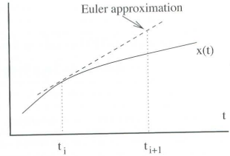
Euler’s Method
Only the term with the first derivative is used:
This method is sometimes referred to as the one-step Euler’s method, since it is performed one step at a time.

Slide 12
Example: One-step Euler’s Method
Consider the differential equation:
For x =1.1
Therefore, at x=1.1, y=1.44133 (true value).

Slide 14
Errors with Euler`s Method
Local error: over one step size.
Global error: cumulative over the range of the solution.
The error ε using Euler`s method can be approximated using the second term of the Taylor series expansion as
If the range is divided into n increments, then the error at the end of range for x would be nε.
Global error: (h is step size)

Slide 15
Example: Analysis of Errors

Slide 16




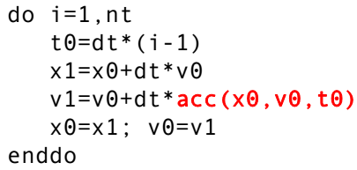
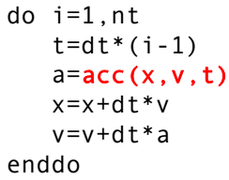

Illustration of Euler Algorithm: Harmonic oscillator
• Consider Newton’s second law:
position
velocity
Define
Discretized time axis
$$=h$$
Fortran implementations:

Slide 17
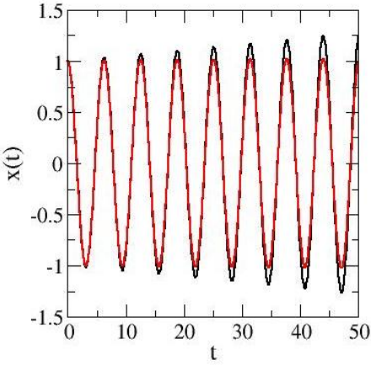
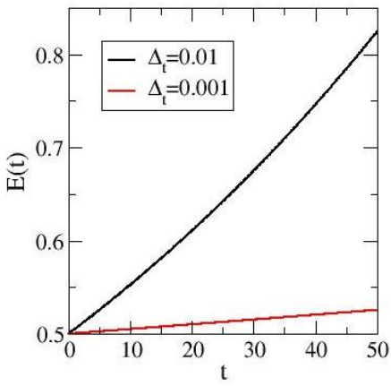

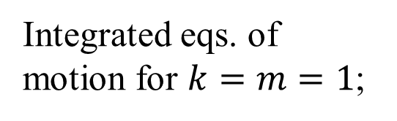
Illustration of Euler Algorithm: Harmonic oscillator
• Euler is not a very good algorithm in practice
• Energy error unbounded (can diverge)
Integrated eqs. of motion for $k=m=1$;

Slide 18
Midpoint method
A better estimate would come from evaluating the f_{i}′ at the midpoint of the Δx interval. The problem: we know x at the midpoint but we don’t know the y_{i} at the midpoint (yet). The solution is to use Euler’s method to estimate Δy and then re-estimate Δy using the derivatives evaluated halfway along the line segment encompassing the original Δy.

Slide 19
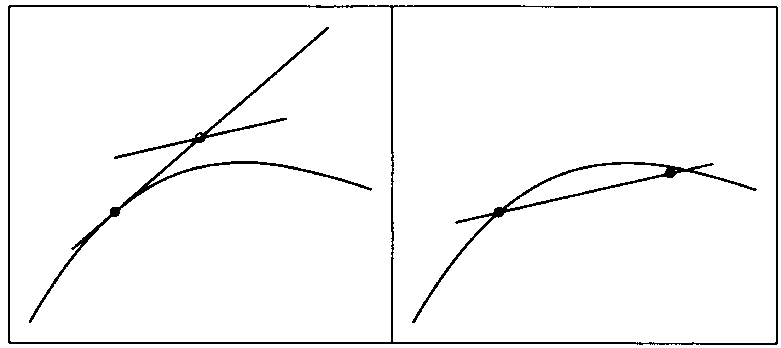
Midpoint method

Slide 20
Modified Euler’s Method
Use an average slope, rather than the slope at the start of the interval :
Evaluate the slope at the start of the interval
Estimate the value of the dependent variable y at the end of the interval using the Euler’s metod.
Evaluate the slope at the end of the interval.
Find the average slope using the slopes in a and c.
Compute a revised value of the dependent variable y at the end of the interval using the average slope of step d with Euler’s method.

Slide 21
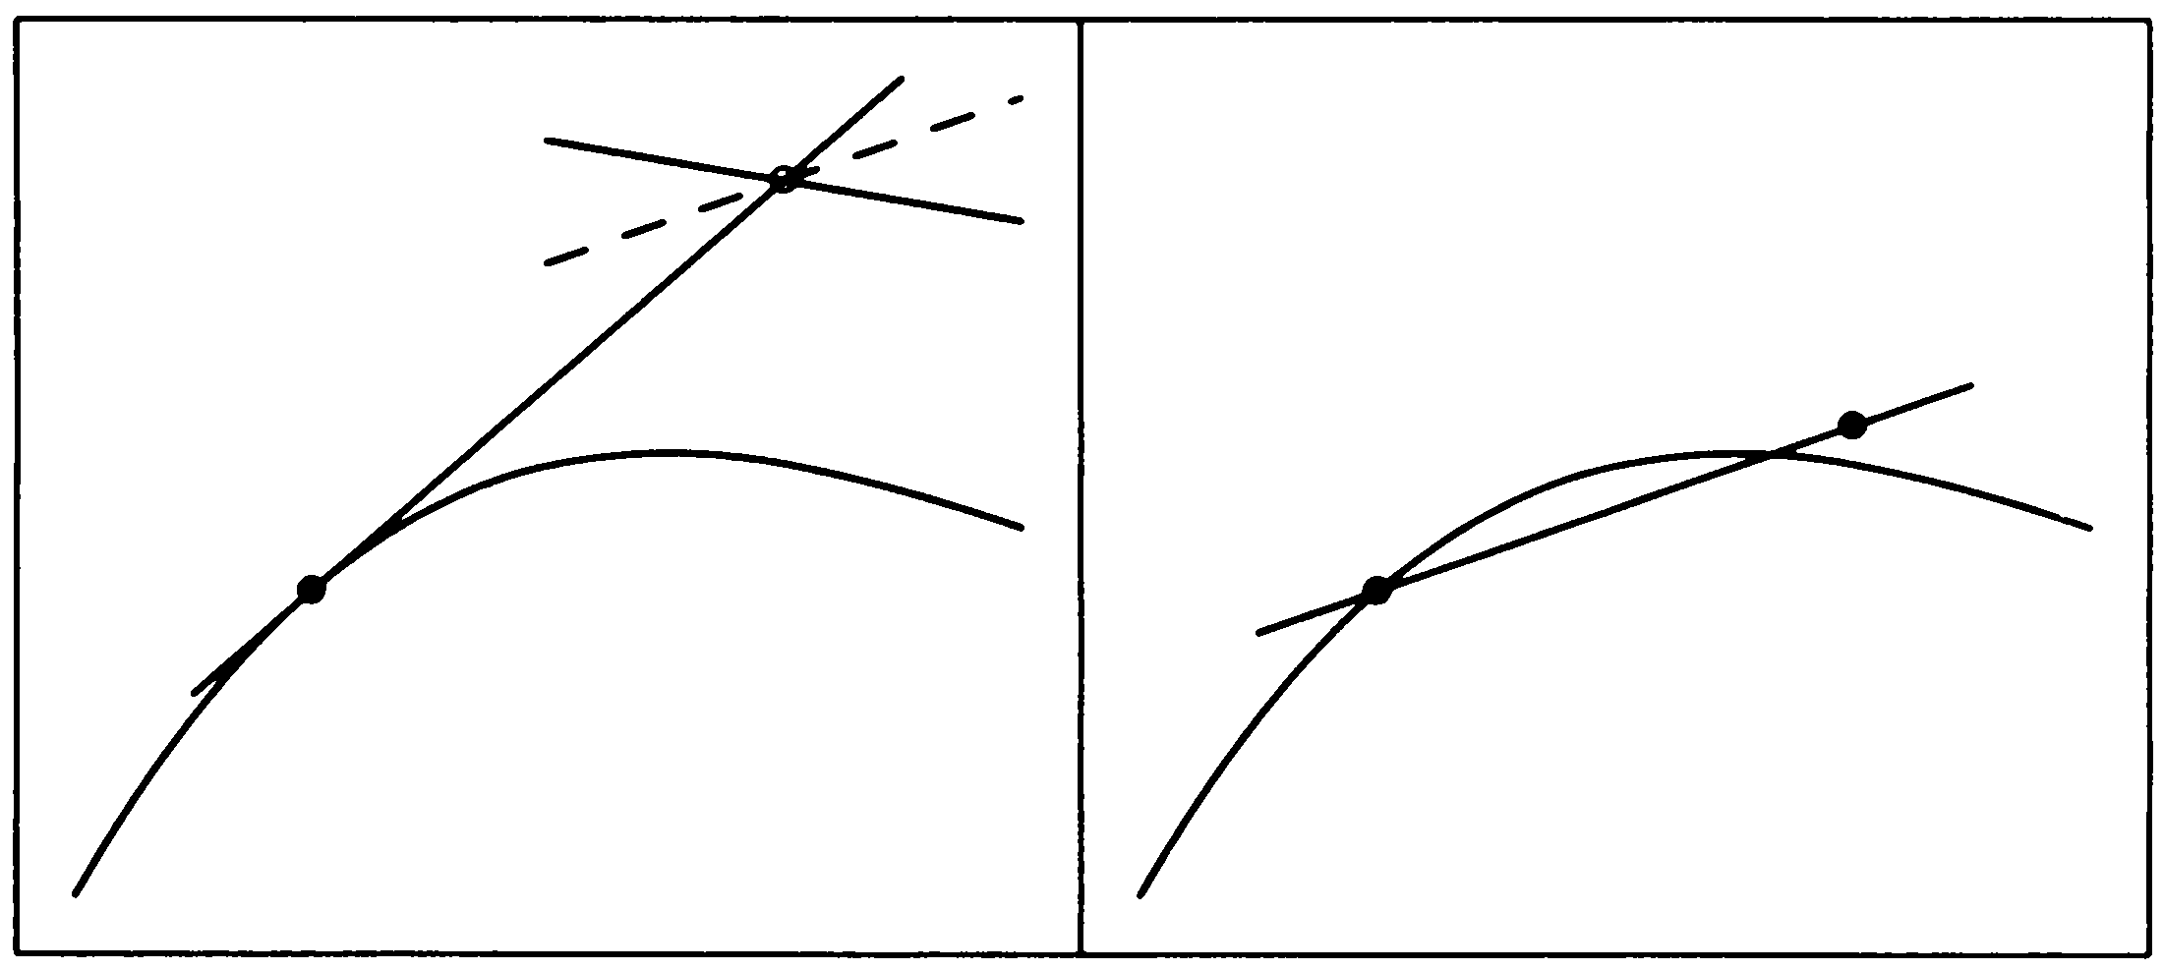
Modified Euler’s Method
Or improved Euler method, or Heun’s method

Slide 22
Example: Modified Euler’s Method

Slide 24
Runge-Kutta Methods

Slide 25
RK Methods (cont)

Slide 26
Taylor’s Expansion

Slide 27
RK 1st Order

Slide 28
RK 2nd Order

Slide 29
RK 2nd Order (cont)
Midpoint
method
Modified
Euler’s method

Slide 30
RK 4th Order
Mostly commonly used one
Higher order … more evaluation, but less gain on accuracy
Classical 4th order RK
Error per step O(h⁵), global error: O(h⁴)

Slide 31
Runge-Kutta 4th order
S: same as k
S₂
S₄
S₃
S₁
x_{i}
x_{i} + h/2
x_{i} + h

Slide 32
Fourth-order Runge-Kutta Methods
Compute the slope S₁ at (x_{i},y_{i}).
Estimate y at the mid-point of the interval.
Estimate the slope S₂ at mid-interval.
Revise the estimate of y at mid-interval

Slide 33
Compute a revised estimate of the slope S₃ at mid-interval.
Estimate y at the end of the interval.
Estimate the slope S₄ at the end of the interval
Estimate y_{i+1} again.

Slide 34
Example
A ball at 1200K is allowed to cool down in air at an ambient temperature of 300K. Assuming heat is lost only due to radiation, the differential equation for the temperature of the ball is given by
Find the temperature at
seconds using Runge-Kutta 4th order method.
Assume a step size of
seconds.

Slide 35
Solution
Step 1:

Slide 36
Solution Cont
is the approximate temperature at

Slide 37
Solution Cont
Step 2:

Slide 38
Solution Cont
θ₂ is the approximate temperature at

Slide 39
Solution Cont
The exact solution of the ordinary differential equation is given by the solution of a non-linear equation as
The solution to this nonlinear equation at t=480 seconds is

Slide 40
Comparison with exact results
Comparison of Runge-Kutta 4th order method with exact solution

Slide 41
Effect of step size
Table 1. Temperature at 480 seconds as a function of step size, h
Step size, h | θ (480) | E_{t} | |є_{t}|%
480 240 120 60 30 | −90.278 594.91 646.16 647.54 647.57 | 737.85 52.660 1.4122 0.033626 0.00086900 | 113.94 8.1319 0.21807 0.0051926 0.00013419
(exact)

Slide 42
Effects of step size on Runge-Kutta 4th Order Method
Figure 2. Effect of step size in Runge-Kutta 4th order method

Slide 43
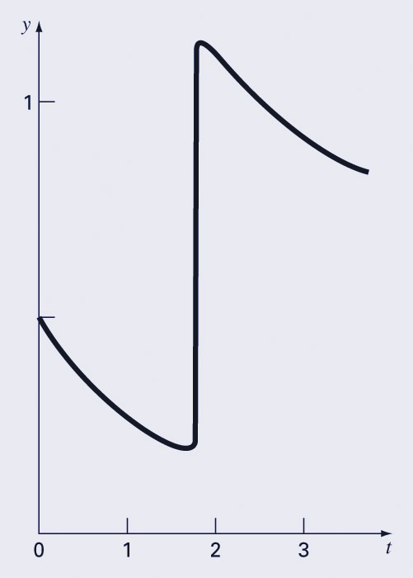
Adaptive Runge-Kutta Methods
The solutions to some ODE problems exhibit multiple time scales - for some parts of the solution the variable changes slowly, while for others there are abrupt changes.
Constant step-size algorithms would have to apply a small step-size to the entire computation, wasting many more calculations on regions of gradual change.
Adaptive algorithms, on the other hand, can change step-size depending on the region.

Slide 44
Adaptive Stepsize Control
Estimate local truncation error from difference between one h step and two steps of h/2
Or difference of 4 and 5-th order Runge-Kutta (Runge–Kutta–Fehlberg method)
Increase h if error is small than tolerance, decrease h if error is bigger than tolerance.
See odeint in Numerical Recipes

Slide 45
Adaptive Step with RK4

Slide 47
Predictor-Corrector Methods
Unless the step sizes are small, Euler’s method and Runge-Kutta may not yield precise solutions.
The Predictor-Corrector Methods iterate several times over the same interval until the solution converges to within an acceptable tolerance.
Two parts: predictor part and corrector part.

Slide 48
Euler-trapezoidal Method
Euler’s method is the predictor algorithm.
The trapezoidal rule is the corrector equation.
Euler formula (predictor):
Trapezoidal rule (corrector):
The corrector equation can be applied as many times as necessary to get convergence.
If only apply corrector once
Heun’s method

Slide 49
Example: Euler-trapezoidal Method

Slide 50
Example: Euler-trapezoidal Method

Slide 54
Code example
The harmonic oscillation.
Euler method: poor accuracy with t = 0.02π.
Predictor-corrector method: much better?
// Predict the next position and velocity
x[i+1] = x[i]+v[i]*dt;
v[i+1] = v[i]-x[i]*dt;
// Correct the new position and velocity
x[i+1] = x[i]+(v[i]+v[i+1])*dt/2;
v[i+1] = v[i]-(x[i]+x[i+1])*dt/2;

Slide 55
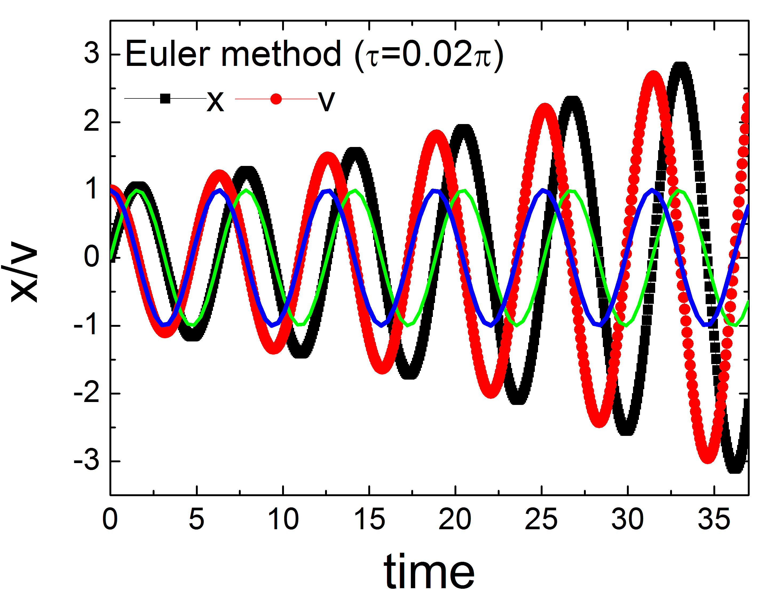
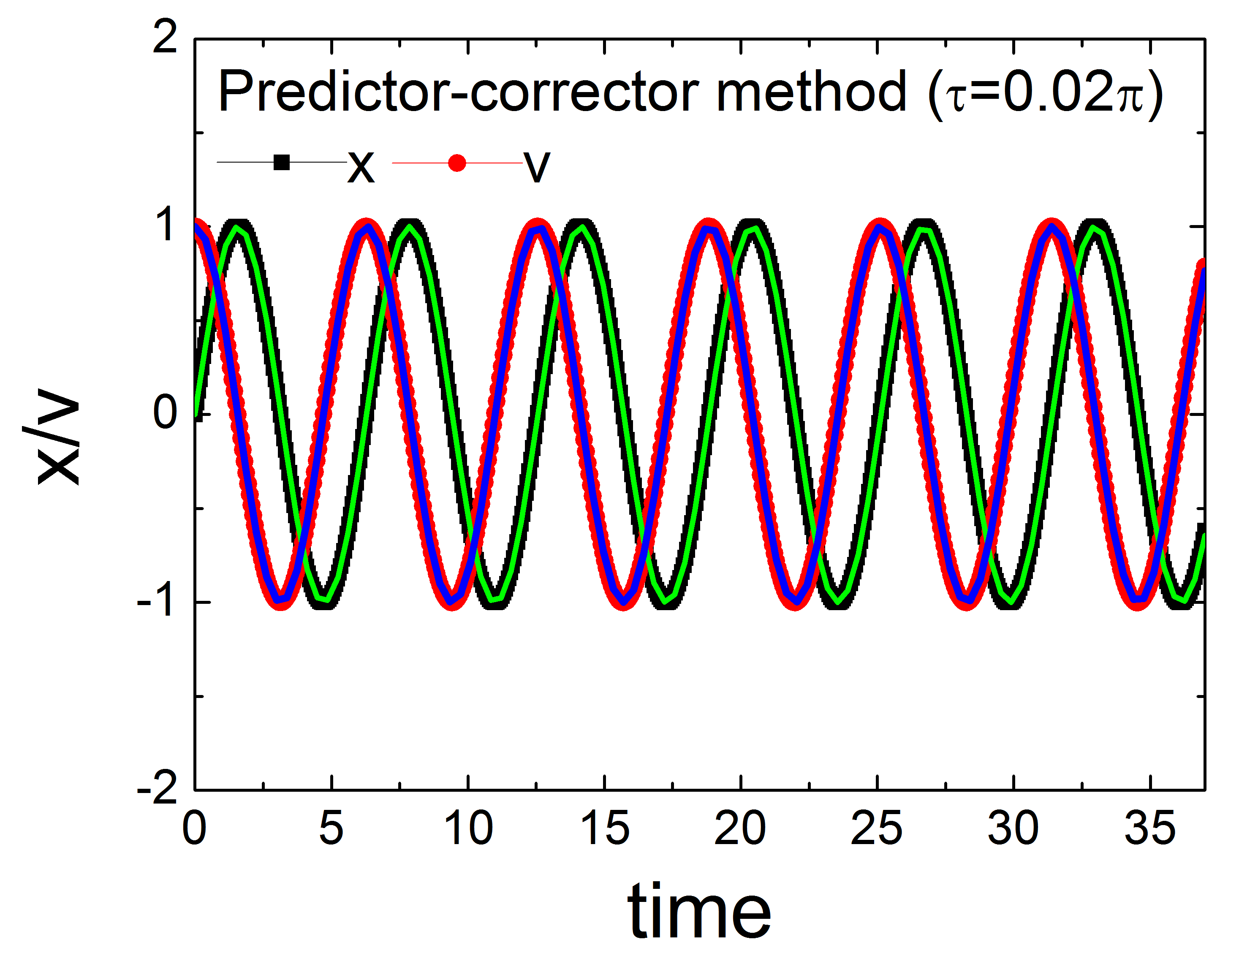
Code example
Predictor-Corrector.cpp

Slide 56
分子动力学模拟
分子动力学模拟是在分子模型的基础上用计算机做实验
通过模拟微观粒子的运动来计算宏观性质
牛顿力学
量子力学
统计力学等
温度
压力
黏度
输运性质
表面张力
．．．．
化学反应
分子间的作用模型

Slide 57
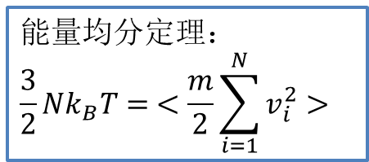
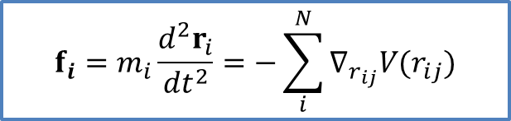
分子动力学简介
压力、电场、磁场、应变应力
$$f_{i}=m_{i}\frac{d^{2}r_{i}}{{dt}^{2}}=−\sum_{i}^{N}{∇_{r_{ij}}V(r_{ij})}$$
气体、固体、液体
方法
结构、形态等
(缺陷、位错、表面)
对象
原子分子尺度
分子动力学
无机材料：固体物化
有机材料：高分子化学、生物医药、蛋白质DNA
能量均分定理：
$$\frac{3}{2}Nk_{B}T= <\frac{m}{2}\sum_{i=1}^{N}{v_{i}^{2}}>$$
结构：成形、演化，相图
性质：热力学性质（能量、温度、热容、压强、声子） 力学性质（硬度等）

Slide 58
粒子运动方程的数值解法
设粒子的坐标、速度及其作用力分别用x(t)，v(t)，f(x,t)表示，其初始值为x(0)，v(0)，f(0)。则决定粒子运动的牛顿方程是

Slide 59
Euler-Cromer算法
• Consider Newton’s second law:
position
velocity
Define
Discretized time axis
$$=h$$
Euler
Euler-Cromer
Local error: O(h²)
Local error: O(h²)
symplectic

Slide 60

Verlet算法
r(t+h) = r(t) + v(t) h + 1/2 a(t) h² + b(t) h³ + O(h⁴) Taylor expand
r(t-h) = r(t) - v(t) h + 1/2 a(t) h² - b(t) h³ + O(h⁴) Reverse time
r(t+h) = 2 r(t) - r(t-h) + a(t) h² + O(h⁴) Add
v(t) = [r(t+h) - r(t-h)]/(2h) + O(h²) estimate velocities
Pros: Time reversal invariance (symplectic) is built in (energy does not drift either up or down).
Cons:
(1) compute difference of two large terms
(2) velocities are not available until the positions have been computed at the next step
(3) not a self-starting algorithm

Slide 61
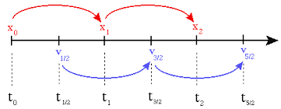
leap-frog algorithm
Pros: it explicitly includes the velocity and also does not require the calculation of the differences of large numbers.
Cons: the positions and velocities are not synchronised.

Slide 62
Velocity-Verlet algorithm
r(t+h) = r(t) +h [v(t) +(h/2) a(t)]
v(t+h) = v(t) + (h/2) [a(t)+a(t+h)]
Error in velocity Verlet algorithm is of the same order as in the basic Verlet algorithm.
Pros: self-starting, smaller round-off error
Widely adopted in MD simulations!

Slide 63

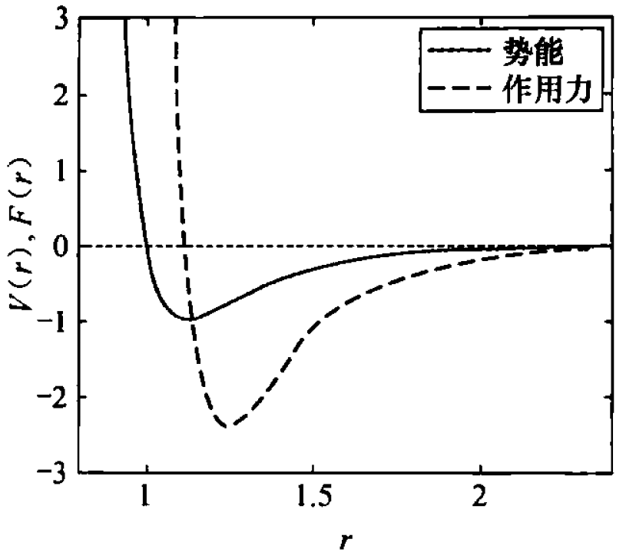
势函数
在Lennard-Jones势作用下，第j个粒子与第i个原子上的力为：
其他势函数：
库仑势
第一性原理势能面
神经网络势函数
…

Slide 64
分子动力学模拟的基本步骤
分子动力学模拟的实际步骤可以划分为四步：
1、设定模拟所采用的模型
模型的设定，也就是势函数的选取。势函数的研究和物理系统上对物质的描述研究息息相关。
2、给定初始条件
运动方程的求解需要知道粒子的初始位置和速度，不同的算法要求不同的初始条件。
如：verlet算法需要两组坐标来启动计算，零时刻的坐标和速度值。

Slide 65
分子动力学模拟的基本步骤
3、趋于平衡的计算过程
为使得系统平衡，模拟中设计一个趋衡过程，即在这个过程中，增加或者从系统中移出能量，直到持续给出确定的能量值。
称这时的系统已经达到平衡。
4、宏观物理量的计算
实际计算宏观物理量往往是在分子动力学模拟的最后阶段进行的。
它是沿着相空间轨迹求平均来计算得到的。

Slide 66
Boundary-value problems
The solution of the Poisson equation with a given charge distribution and known boundary values of the electrostatic potential.
Wave equations with given boundary conditions.
The stationary Schrodinger equation with a given potential and boundary conditions.

Slide 67
One-dimensional example
Where u is a function of x, u' and u'' are the 1st and 2nd derivatives of u with respect to x;
f(u,u';x) is a function of u, u', and x.
Either u or u ' is given at each boundary point (x=a and x=b).

Slide 68
For problems in one dimension, we can have a total of four possible types of boundary conditions:
(1) u(a) = u_{a} and u(b) = u_{b};
(2) u(a) = u_{a} and u'(b) = v_{b};
(3) u'(a) = v_{a} and u(b) = u_{b};
(4) u'(a) = v_{a} and u'(b) = v_{b}.
(2) is the same as (3) by reversing the direction.

Slide 69
The boundary-value problem is more difficult to solve than the similar initial-value problem with the differential equation.
For example, if we want to solve an initial-value problem and the initial conditions u(a) = u_{a} and u'(a) = v_{a}, the solution will follow the algorithms discussed earlier.
However, for the boundary-value problem, we know only u(a) or u'(a), which is not sufficient to start an algorithm for the initial-value problem without some further work.

Slide 70
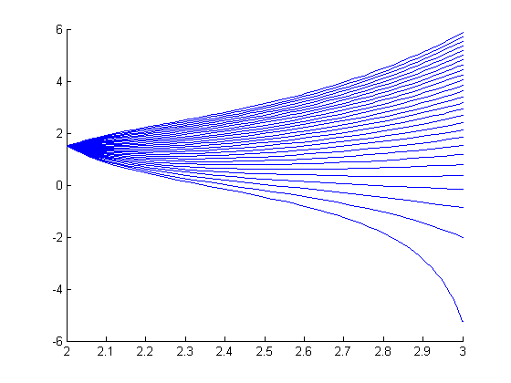
u(a) = u_{a}
u(b) = u_{b}
u⁽²⁾(x) = f(x, u(x), u⁽¹⁾(x))
A boundary-value problem could be restated as:
Given one initial condition u(a) = u_{a}, what slope is required at that initial point so that the solution to that initial condition passes through the point (b, u_{b})?
(b, u_{b})
(a, u_{a})

Slide 71
Boundary-value problem for 2nd-order ODEs
We will consider two possible cases:
When the ODE is linear, and
When it is not
(b, u_{b})
(a, u_{a})

Slide 72
2nd-order Linear ODEs
A 2nd-order ODE is said to be linear if it can be written as
u⁽²⁾(x) + q(x) u⁽¹⁾(x) + r(x) u(x) = g(x)
or
u⁽²⁾(x) = g(x) – q(x) u⁽¹⁾(x) – r(x) u(x)
We will also consider the corresponding homogenous LODE:
u⁽²⁾(x) + q(x) u⁽¹⁾(x) + r(x) u(x) = 0
or
u⁽²⁾(x) = –q(x) u⁽¹⁾(x) – r(x) u(x)

Slide 73
2nd-order Linear ODEs
To demonstrate 2nd-order LODEs, we will consider the example
The corresponding homogeneous LODE is the

Slide 74
Recall that if u_{g}(x) is a solution to a 2nd-order LODE and u₀(x) is a solution to the corresponding homogenous LODE, then
u_{g}(x) + c·u₀(x)
is also a solution the LODE
g(x)
0

Slide 75
Solve boundary-value problem for 2nd-order LODEs
Suppose we have redefine a boundary-value problem in terms of two IVPs, the first on the LODE with constraints
and the second on the homogenous LODE with constraints
Let u_{g}(x) and u₀(x) be the solutions, respectively

Slide 76
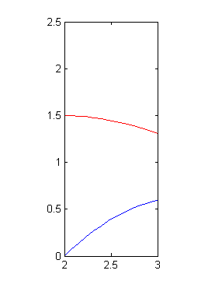
For example, given the LODE from before, we create the two IVPs
(b, u_{b})
(a, u_{a})
u_{g}(x)
The plots of the solutions:
u₀(x)

Slide 77
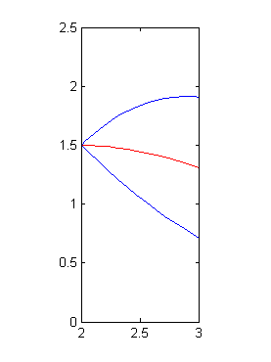
Having found these two solutions, u_{g}(x) and u₀(x), we now want to find a linear combination
of these two such that it satisfies the second boundary value
For example, here we see
u_{g}(x), u_{g}(x) + u₀(x), and u_{g}(x) – u₀(x)
It seems u_{g}(x) + 2u₀(x) will pass close to the second boundary point
(b, u_{b})
u_{g}(x) + u₀(x)
(a, u_{a})
u_{g}(x)
u_{g}(x) – u₀(x)

Slide 78
We want to find the appropriate linear combination
to match our second boundary condition
First, we note
We want
Solving this for c yields

Slide 79
Alternative method for solving 2nd-order LODEs
u(0) = u₀
Obtain two trial solutions u_{α0} (x) and u_{α1} (x) of the IVP with u(0) = u₀, where α₀ and α₁ are two different values of u'(0).
The correct solution of the equation is given by
where a and b are determined from u(0) = u₀ and u(1) = u₁. Note that u_{α0}(0) = u_{α1}(0) = u(0) = u₀. So we have

Slide 80
Code example
Boundary.cpp
u(0) = 0 and u(1) = 1

Slide 81
2nd-order Non-linear ODEs
What happens if the ODE is not linear?
In this case, there is no guarantee that we can find a solution using the previous simple technique
Instead, we will use
u⁽²⁾(x) = f(x, u(x), u⁽¹⁾(x))
and let u_{s}(x) be the solution to the IVP
u(a) = u_{a}
u⁽¹⁾ (a) = s
Now, define a new function
err(s) = u_{s}(b) – u_{b}
The shooting method
When this function has a zero, we have a solution to the BVP

Slide 82

The shooting method
Guess a value
for s
Calculate u_{s}(b)
u_{b}-u_{s}(b)
adjust s
not
converge
Find root using secant method or bisection method
converge
Correct s

Slide 83
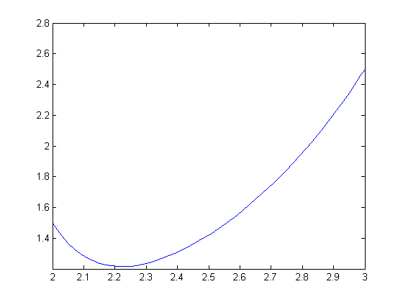
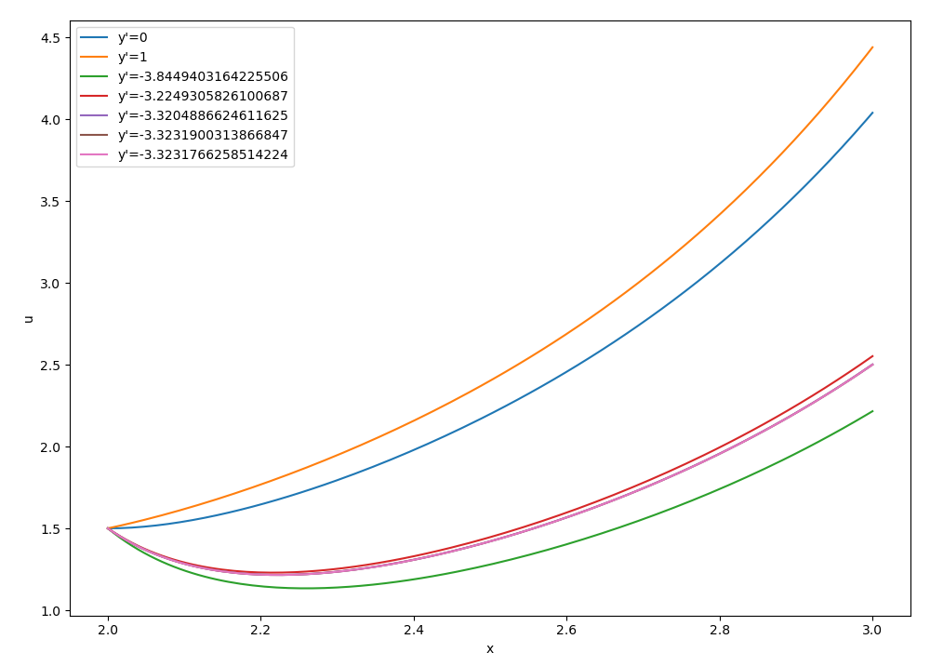
Shooting Method: example
Consider the following non-linear BVP:

Slide 84
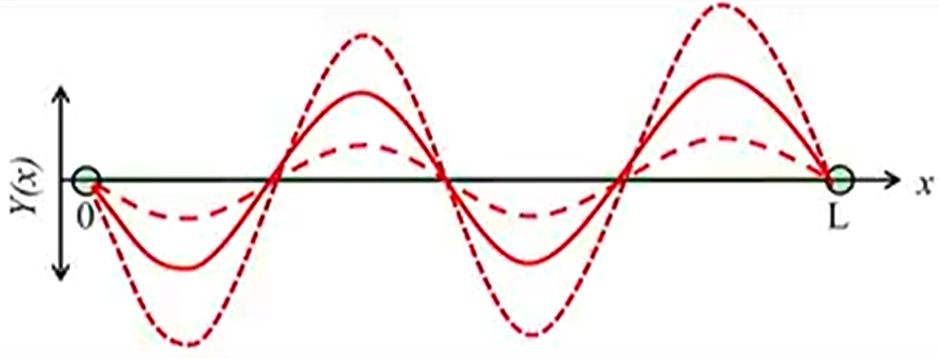
Shooting method for eigenvalue problem
λ is also unknown.
Select an arbitrary non-zero y'(0) (note that the magnitude of y does not matter)
Choose a trivial λ, compute y(1) with this λ
Adjust λ so that the computed y(1) = 0

Slide 85
Finite-Difference Methods
The most common alternatives to the shooting method are finite-difference approaches.
In these techniques, finite differences are substituted for the derivatives in the original equation, transforming a linear differential equation into a set of simultaneous algebraic equations.

Slide 86
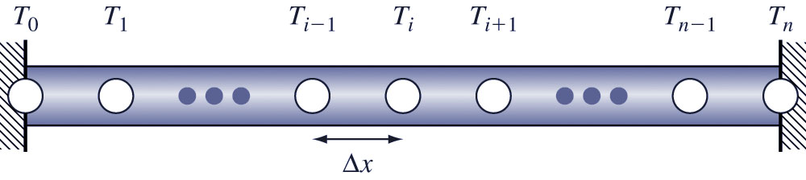
Finite-Difference Example
Convert: into n-1 simultaneous equations at each interior point using centered difference equations:

Slide 87
Finite-Difference Example (cont)
Since T₀ and T_{n} are known, they will be on the right-hand-side of the linear algebra system (in this case, in the first and last entries, respectively):
Can be solved, e.g., by Gaussian elimination

Slide 88
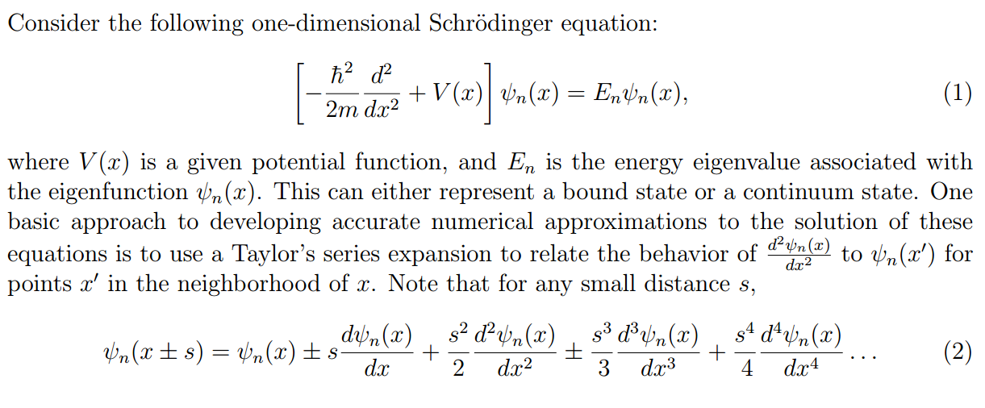
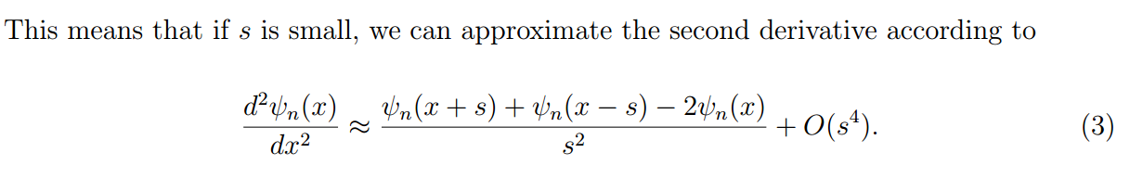
Numerical methods of solving the 1D Schrödinger equation
!
!
!

Slide 89

Numerical methods of solving the 1D Schrödinger equation -- continued
x
x₀=0
x₃
x₄
x_{N-1}
x_{N}=a
s
Discretize x into N segments s, with s=a/N.

Slide 90
Numerical methods of solving the 1D Schrödinger equation -- continued

Slide 91
In this way, our numerical solution is cast in terms of an
eigenvalue problem where the N-1 unknown eigenvector
components are ψ_{n} (x_{i})

Slide 92
Example for N=7:
n | λ | λ/s² | E_{v}
1 | 0.1980622645 | 9.7050509605 | 9.869604401
2 | 0.7530203960 | 36.897999404 | 39.47841760
3 | 1.554958132 | 76.192948468 | 88.82643960
4 | 2.445041868 | 119.80705153 | 157.9136704
5 | 3.246979605 | 159.10200064 | 246.7401100
6 | 3.801937736 | 186.29494906 | 355.3057584

Slide 93
Convergence of results with respect to N
Numerical results from second-order approximation:
 | N=4 | N=8 | Exact
n=1 | 9.54915028 | 9.7697954 | 9.869604404
n=2 | 34.54915031 | 37.9008002 | 39.47841762
Numerical results from Numerov approximation:
 | N=4 | Exact
n=1 | 9.863097625 | 9.869604404
n=2 | 39.04581620 | 39.47841762

Slide 94
Numerov method for integrating Schrödinger equation
Integrating ordinary differential equations of second order in which the first-order term does not appear.
1D Schrödinger equation
Numerov method for integrating the equation:
See http://physics.ucsc.edu/~peter/242/numerov.pdf
Combine with shooting method for solving BVP

Slide 95
Homework
1. Write a code to numerically solves the motion of a simple pendulum using Euler’s method, midpoint method, RK4, Euler-trapezoidal method (implement these methods by yourself). Plot the angle and total energy as a function of time. Explain the results.

Slide 96
2. Write a code to numerically solves radial Schrödinger equation for
V(r)=-1/r (hydrogen atom)
(2)
erf: error function
Z_{ion}
r_{loc}
C₁ C₂ C₃ C₄
See https://journals.aps.org/prb/pdf/10.1103/PhysRevB.47.4174
Compute and plot the first three eigenstates

Slide 97
Solve radial Schrödinger equation
For a spherically symmetric potential, the solution of the Schrodinger equation can be written as
Shooting method: The energy eigenvalues can be found by integrating the radial Schrodinger equation from some large radius r_{max} inward to r = 0 and checking whether the solution vanishes there.
For the starting values at r_{max}, you can take u(r_{max})=0, u(r_{max}-h) equal to a very small value.

Slide 98
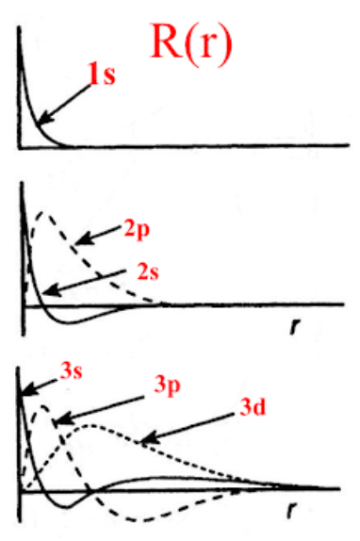
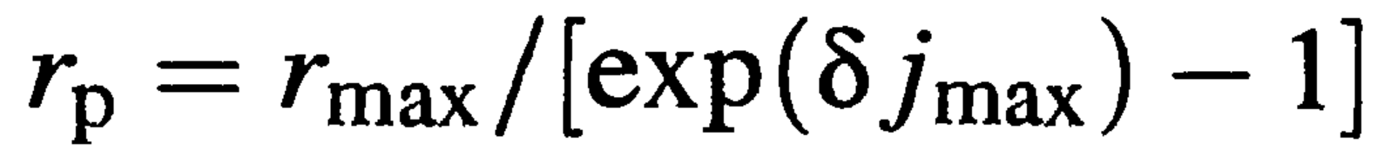
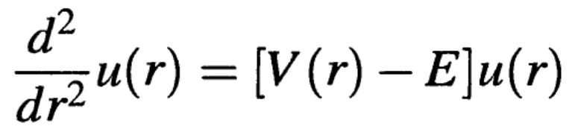
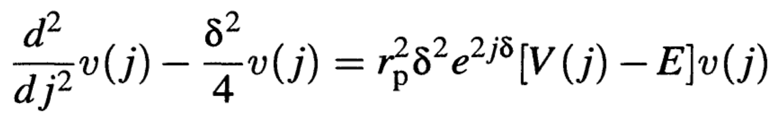

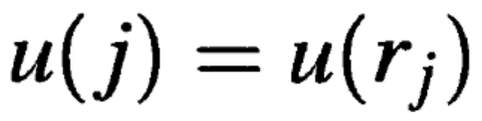
Use of non-uniform grid (optional)
Consider a grid with grid points
given by the following formula:
in terms of j, the radial Schrodinger equation becomes
wave function oscillates more rapidly near the nucleus

Slide 99
供参考：https://www.iue.tuwien.ac.at/uploads/tx_sbdownloader/Bachelor-Arbeit_Marie_ERTL_09-2016.pdf#:~:text=The%20shooting%20method%20is%20a%20numerical%20method%20to,parameter%20energy%20as%20the%20eigenvalue%20of%20the%20system.

